Slide 1
HDX Curriculum Design
Creating a sustainable economic recovery
A future of uncertainty requires resiliency: robustness and flexibility

Slide 2
HDX VALUE PROPOSITION
Happy Digital X: Cities, Systems, Products and Services, a professional education program to strengthen capabilities of practitioners in developing happy cities
By enhancing skills and knowledge of sustainable development; design thinking on cities, systems, products and services; computational thinking for enhancing ICT capabilities; systems thinking for ICT integration into the city; and capacity for transformational leadership.
Designed to enable cross-discipline integration, both in theory and practice through a process of active and reflective learning. Facilitated by reputable global and local experts through synchronous and asynchronous learning that allows for flexible learning hours.

Slide 3
HDX MARKET SEGMENTATION
Beach head market: government employees working on and in cities
Early – mid career professionals
Echelon IV – II (Indonesian civil service rank)
Working in city/regency agencies on ICT transformation
Commercial sector
Early – mid career professionals applying ICT
‘The Bosses’
People who supervise the early – mid career professionals
Who want to participate in entire 12 week program
Executive version of Happy Digital X
Targeted towards executives
Will learn what the participants have learned
Will be involved in plenaries
Entrepreneurs and ICT experts
Participants with tech background, able to bring value for other participants

Slide 4
Six threads plus the projects
Grand
challenges
Six threads teach background knowledge, skills and tools
Project based learning: policy, projects, strategy and road-mapping
skills
solutions
Tools
Skilled
workforce

Slide 5
Defining the projects
Project choice are driven by:
Global Grand Challenges – sustainability, health, security and joy of living
Indonesian medium term development agenda
And influenced by the:
The vision and mission of TSEA
The UN SDGs
The specific needs of stakeholders
The HDX program objectives
Reflecting key themes
Happiness and sustainability
ICT transformation

Slide 6
Indonesian MEDIUM TERM DEVELOPMENT AGENDA RPJMN 2020-2024
1. Strengthening economic resilience for quality growth 2. Regional development for reducing inequality 3. Upgrading human resource qualification and competitiveness 4. Mental revolution and cultural development 5. Strengthening the infrastructure for supporting economic development and basic needs 6. Building the living environment, increasing disaster resilience and climate change 7. Strengthening politics, law, defense and security stabilization and public service transformation

Slide 7
Potential projects
Grand challenge | Systems change goals | Projects
National Plastic Action Partnership | Reduce or substitute plastic usage | ICT based gamification for consumer behavior change
 | Redesign plastic products and packaging for reuse or high-value recycling | Packaging innovation for one product type (eg soap & shampoo)
 | Double plastic waste collection | Smart urban waste management system for one city/regency (eg Bali)
 | Double current recycling capacity | ICT-based systems innovation for plastic recycling
 | Build or expand controlled waste-disposal facilities | Smart waste disposal facilities

Slide 8
Discussion question 1
Based on your knowledge of the global and regional grand challenges, what are some projects that capture the essence of the challenge at appropriate scope?

Slide 9
Six threads plus the projects
Happiness, sustainability
Leadership
skills
Urban planning
Grand
challenges
System design and management
Project based learning: policy, projects, strategy and road-mapping
solutions
Entrepreneurial product development
Skilled
workforce
Application oriented ICT
ICT integration to the city
Notes:
The suggestion that we might have a platform approach, with special programs for cities, systems and products

Slide 10
Structure and function of each thread
Plenary
Introduction to thread
Skill development clinics
(~3 per thread)
Project based learning
Inspiration
Motivation
Global view
Grand challenges
SH understanding
Information
Survey of thread
Skills intro
Project intro
Skills
Procedures
Exercise
Experience
Solutions based on grand challenges
Background reading and viewing
Topical advisors and specialized reading and viewing
time

Slide 11
Discussion question 2
What is your assessment of the skills outlined in the attached slides – do they leave the learner with increased capability?

Slide 12
Notional effective and measurable skills (1)
Organizational transformation and change management
Happiness: analyze what keeps people in cities happy and link it to decision making
Sustainability: develop plans for applying and measuring selected SDG related norms of sustainability
Leadership: demonstrate transformational leadership of small groups and plan for larger scale transformation
Information communications technology
Data organization and data assets: explain how data is organized (centralization and distribution), and how the value of the data depends on its quality, curation and organization – knowing what GOOD big data
ML: explain how to formulate the input to ML, and interpret how the results of ML operation affects cities, systems and products
Secure data: explain the importance of data security, describe approaches, and prescribe appropriate level of security (Blockchain)
Digital work flow: demonstrate an ability to participate in remote locations, producing scalable and fast response to opportunity, using online protocols and tools

Slide 13
Notional effective and measurable skills (2)
ICT integration in the city
City as a system: Analyze a city as an array of interconnected systems, and describe the plan for its operation in the presence of uncertainty and response to emergencies of many kinds
Senseable city: design an intentional array of actuators and sensors that provide a new capability to the city
Decisions: Identify key decisions and alternatives, along with metrics, and view the options that result; use this analysis to form a plan or design
Implementation: develop and monitor approaches to the implementation of a project, system or product, particularly with regard to targets and milestones

Slide 14
Notional effective and measurable skills (3)
Urban design:
Consensus: Demonstrate building consensus among the stakeholders of a community scale project
Digital transformation: Identify what in the city can be digitized and to what good
Design: Analyze good urban design
[Interpret and influence urban planning and governance]
[regional and national economic impact]
System design:
Goals: Identify the needs of the system stakeholders and set related goals
Trade-offs: Analyze several proposed architectures and trade off among them
Emergence: Identify interfaces and relationships among system entities, anticipate the impact on emergence, and validate performance

Slide 15
Notional effective and measurable skills (4)
Product development – goods, services and entrepreneurial ventures:
Foundation: identify the initial product and its market; its competitors and competitive advantage
Value creation: develop the product by agilely considering customer preferences, aesthetic, technology, identifying the sources of finance and potential economic return
Scale up: describe how to scale up the product through manufacturing, marketing, sales, and distribution

Slide 16
Next steps
Shobi, Ben and Ed will conduct 3+2 or so zoom discussions next week to brainstorm
Week after next we will integrate and have another of these discussions
Questions for discussion:
Projects of right scope? Who can lead them?
Good set of skills? Who can teach them”

Slide 18
3 Blocks of time
It might be useful to consider the curriculum as three blocks in time. Each would be about 4 weeks long, and there would be a rest week between segments. The flow might be:
Block 1: forming groups, learning fundamentals in survey courses, sustainability, happiness, leadership, intro to projects, learning design
Block 2: resource for skills, ramp-up of projects,
Block 3: complete project while accessing resources

Slide 19
Benchmark
 | Sustainability | Sustainable Cities | Sustainable ICT
Offline programs | Master’s of Development Practice, Columbia University Master of Public Policy for SDGs at Tsinghua University Portland State University Graduate Certificate in Sustainability | Urban Fellowship program at Indian Institute for Human Settlements Master of Architecture in Future Human Habitat Design at Tsinghua SIGS Special Program for Urban and Regional Studies (SPURS) at MIT Department of Urban Studies and Planning | Erasmus Mundus Joint Master Degree (EMJMD) in Pervasive Computing and Communications for Sustainable Development (no longer offered)
Online programs | SDG Academy MOOCs by Sustainable Development Solutions Network Executive Leadership Programme in Evaluation and the Sustainable Development Goals by the UN Institute for Training and Research | MOOC on Sustainable Cities by SDG Academy, offered by IIHS CitiesX: The Past, Present and Future of Urban Life MOOC by Harvard University on edx.org | ”Beyond Smart Cities: Emerging Design & Technology” executive program by MIT Media Lab MOOC on Tech for Good: The Role of ICT in Achieving the SDGs on EdX, offered by SDSN’s SDG Academy “AI Society 4.0: from Earth to Space” by the Amsterdam Law and Technology Institute, Vrije University

Slide 20
Main message - a curriculum which is centered on leaner experiences
The project that the participants work on are based on “grand challenges”
The skills and tools that the participants acquire are those necessary to solve the problems
The principles and methods that the participants acquire are in the domains of computational, systems and design thinking, and provide the context for the skills and tools

Slide 21
HDX program objectives
The program in Happy Digital X will contribute to the development of Indonesian cities, systems and products, and make efficient use of resources. It will help the nation to:
Develop urban plans that meets community goals and makes residents happy
Provide for sustainable development and operation of the city, the systems in the city, the products and services used in the city
Prepare a cadre of educated digital experts, entrepreneurs and transformative leaders, in the domains of happy digital X, as we define them
Develop a referenceable roadmap for ICT deployment
Facilitate the digital transformation process towards happy digital cities, in the form of research, mentoring/consulting, and training/capacity building.
Collaborate in partnership with the government to create a pilot for a digital urban transformation initiative.

Slide 22
Vision
The vision we have is for an increasingly united Indonesia, with harmony among its people, and the provision of sustainable food and shelter, improving health, and equitable economic, social and cultural development. We foresee harmony with the natural ecosystem and eventually environmental restoration. We envision harmony with spirit.
These three paths to happiness are informed by the Balinese tradition of Tri Hita Karana. And they align well with the UN Sustainable Development Goals (UN SDGs).

Slide 23
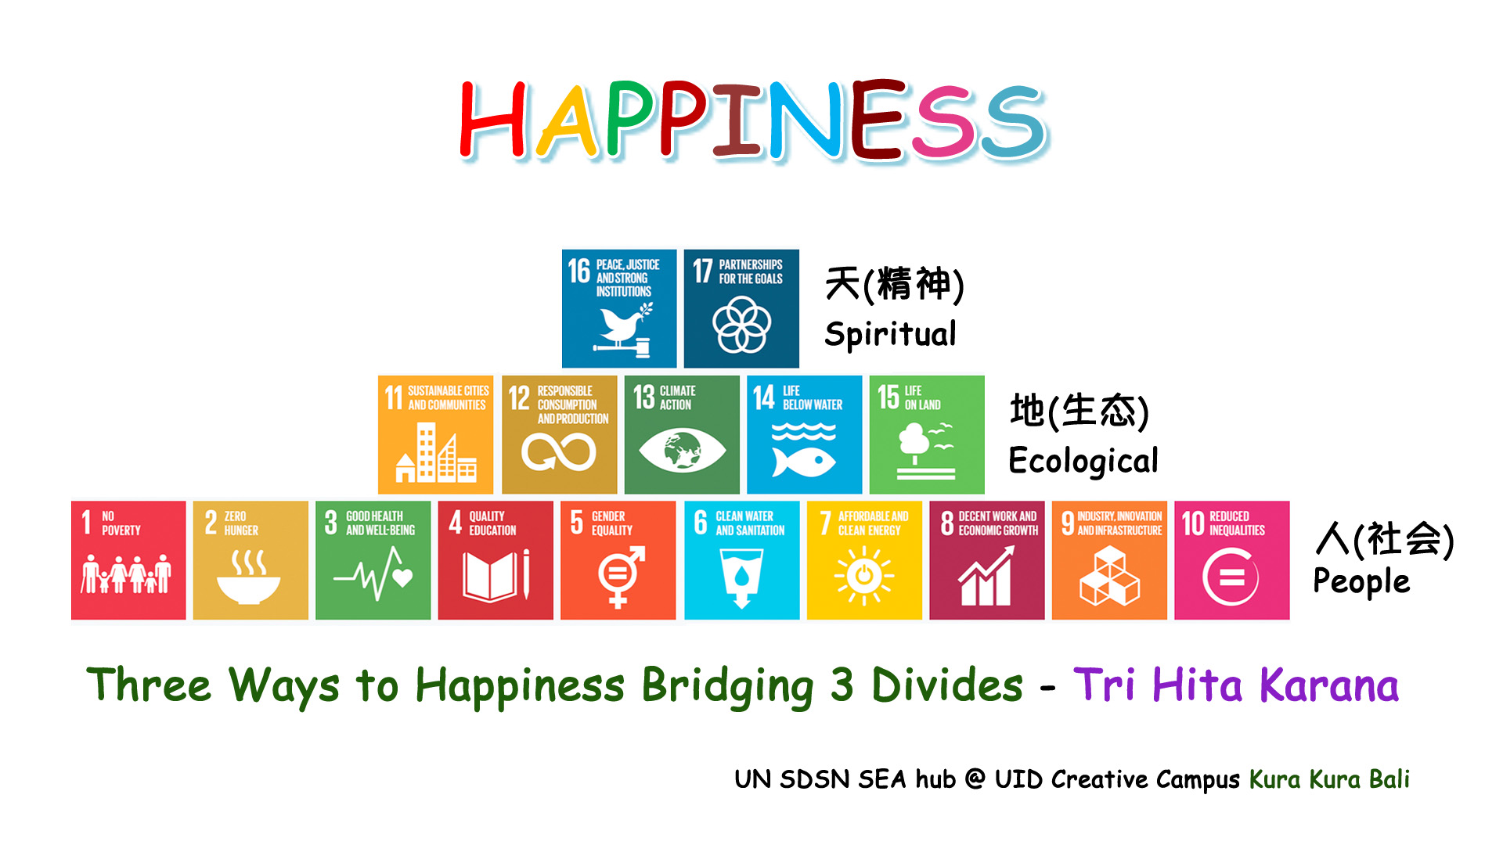
Figure 1 – Tri Hita Karana and the SDGs

Slide 24
Mission of TSEA
To nurture trust in society, promote environmental sustainability and regeneration, and drive equitable economic development and public health in Bali, Indonesia and beyond
By employing system thinking, multi-sector engagement and transformational leadership to educate creative individuals, make research discoveries and create innovations, including policies, practices and technologies
Our tri-sector, professional, and postgraduate programs will educate participants, oversee the exchange of students and faculty, and conduct outreach events

Slide 25
Needs of stakeholders
After extensive discussions with stakeholders in government, industry and civil society, we identified the following program needs and trends:.
Emerging from COVID 19 and its issues of public health, there is a growing need for economic redevelopment and for employment, particularly among the “demographic bonus” of millennials.
Nearly 60% of Indonesia’s almost 300 million citizens reside in 98 cities and 416 rural towns (regencies). Our canvassing of the issue reveals that a vast majority of these towns (96%) do not possess detailed spatial plans, and there have been very few clear roadmaps on how to transform these loci into more sustainable digital habitats.
Stakeholders report gaps in human awareness of the huge potential of technology in enabling a better future, particularly in ICT transformation and urban infrastructure and services.
There are significant gaps in IT literacy at the grassroots level, blocking citizens from using ICT for entrepreneurial ventures and new products, lifelong learning and as a tool for managing social spaces and relationships.
We heard observations regarding gaps in the human capacity both in the technical-practical aspects as well as leadership and governance aspects of change implementation.

Slide 26
Notional projects
Thread | Cities | Systems | Products
 | ICT plan for the new capital in Indonesia | Design of government provided senseable urban system (eg traffic control) | App for access to government held data
 | ICT enabled planning for small cities and regencies | Design of commercially provided ICT system (eg banking) | App for commercially motivate data based product
Notes:
Shobi to supply doc

Slide 27
Learning outcomes cluster around six threads and the need to learn practice
A foundational thread on happiness, sustainability and transformational leadership
A thread on application oriented ICT – computational thinking – which would include ML, big data, service mesh, etc.
A thread on system thinking and integration, which links the ICT and design topics
Urban planning including the services from the land – a type of design thinking
System design and management of more complex systems and their services – a type of design thinking
Entrepreneurial product development, including associated services they provide – a type of design thinking
A set of project based learning experiences, to solidify understanding and develop skills of implementation and self-efficacy.

Slide 28
Student learning experience based design
Start with the end point: participants should be better able to address the grand challenges
But these are far to big to work on as learning exercises, so we will identify projects inspired by the grand challenges
So what skill do the participants need to develop to work on the project – this drives the design of the threads

Slide 29
Curricular concept
Students learn principles, methods, and tools in the six threads
Each thread has:
Some read-ahead or watch-ahead to strengthen background
A visionary “grand challenge plenary”
Framing and scoping the project linked to the grand challenge
A substantive introduction which introduces 3 or 4 key principles, methods and tools
Several clinics that develop skills in the tools
A set of resources (reading and viewing) as well as available experts that deepen knowledge and sills
Tools are practiced on policies, projects, strategies in the practicum
Application of the methods and tools to a representative challenge

Slide 30
Grand challenges and representative projects
The integrated project experiences are motivated by three or so real grand challenges important to Indonesia and the region
The project work is organized around a set of projects linked to the grand challenges but of a scope that participants can apply tools, demonstrate skills, and produce concrete results
Projects are linked to the interests of sponsors and other key stakeholders, and participants

Slide 32
Figure 3 – Joint design curriculum in detail
Organizational transformation
Happiness
Harmony, contentment
Leadership
Harmony, contentment
Sustainability SDGs in context
City. system, product
ICT integration into the city
ICT Capabilities
Urban design
Introduction,
System
Introduction
Data and ICT ecosystem (intro)
System design
introduction
Decisions
ML, algorithms, data
Product design
Introduction, strategy
Models
Coding
Urban policy and governance
Digital/physical/human interaction
Digital publishing
Prototyping, IP, manufacturing
Implementation
Service mesh
Project finance
Management of uncertainty
Cyber security
Integrative project experiences
New policy
Develop and implement one policy
Project studio
Problem, solution, implementation
Roadmaps
Scenario planning
Notes:
A mixed curriculum with some exposure to city design, system design and product design

Slide 33
Reducing topics to implementable 180 hr curriculum
Think of topics as resources that can be learned and used to learn
People, books, on-line resources cases, study visits
Think of the “mesters”
1: forming groups, learning fundamentals in survey courses, sustainability, happiness, intro to projects
2: resource for skills, ramp projects,
3: complete project while accessing resources
Filter topics by ability to assess
Filter topics by those that will directly impact application and skills
Create excitement
Develop insight of how to expand to 9 month (540 hr)

Slide 34
What would success today look like?
Acknowledgement of the larger team
Campus, MAP, GiTech, Polytechnic
Priorities for 2021
Organization to address priorities
Less firefighting and more planful work
Implementation of process standards
Key organizational decisions’
Key variables to measure

